Slide 1
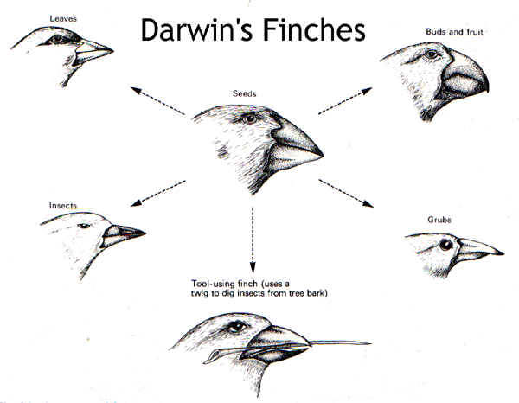
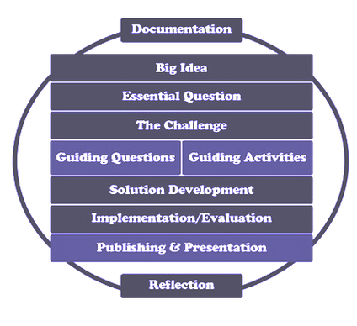
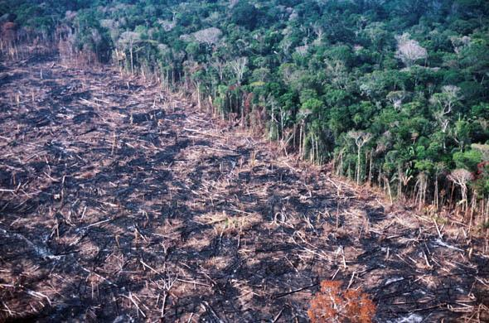
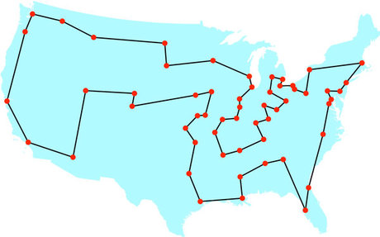
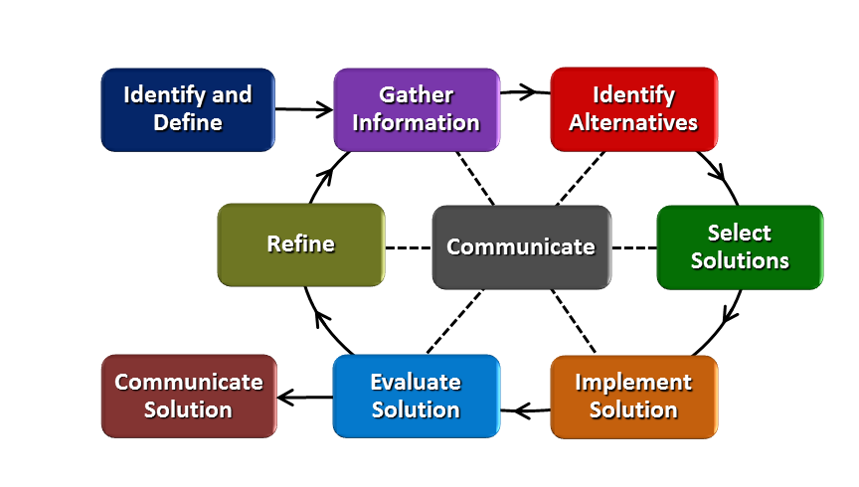
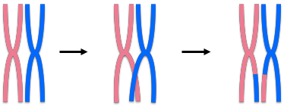
Natural Selection: Optimizing Life Ryan Wright Ryle High School, Biology, 9th-10th Grade
RET is funded by the National Science Foundation, grant # EEC-1404766
Summer Research:
Classroom Connections
Implementing w/ Students:
Project Title:
“Bio Inspired Optimization of the Traveling Salesman Problem”
Research Overview:
AI and Computational Thinking:
2-OPT Method:
Genetic Algorithms:
My approach:
Can we apply computational optimization strategies to life processes?
Challenge Based Learning:
Asks students to:
-Evaluate what they need to know.
-Create their own challenge.
-Formulate their own solutions.
-Share findings.
Engineering Design Process:
Students learn the importance of:
-Multiple solutions.
-Refining Ideas
-Research and Testing
-Communication and Teamwork
Big Idea: Natural Selection
-Changing climates
-Increased human activity
-Habitat loss
Can life adapt to these changes?
Goal:
Students will be able to connect computational optimization strategies to natural selection.
Things to learn:
Connections between fitness, adaptations, and natural selection?
What challenges do organisms face?
How do less fit organisms compensate/survive?
How does a computer “think”?
http://evolution101.yolasite.com/resources/darwins_finches.jpg
http://www.windwardcbl.org/uploads/2/8/9/5/28952705/9422711.png?425
https://thumbs.dreamstime.com/z/algorithm-27863175.jpg
http://graphics8.nytimes.com/images/2012/03/14/theater/14salesman-map/14salesman-map-custom1.jpg
https://climate.nasa.gov/internal_resources/94/
http://www.globalmarshallplan.org/sites/default/files/imce/amazon-deforestation.jpg
https://hackaday.io/project/4955-g-code-optimization
https://previews.123rf.com/images/photokanok/photokanok1201/photokanok120100013/11901045-Business-man-hand-drawing-flow-chart-isolated-Stock-Photo-flowchart.jpg
https://media.quizizz.com/resource/gs/quizizz-media/questions

